Slide 1
Sing, Sing, Sing! Book 3 “Aim Even Higher”

Slide 2
Sing Sing Sing!
A progressive Singing Scheme from Hertfordshire Music Service’s Primary Music Team.
Singing is great, and we do it for lots of reasons; there are songs from different times and places, songs in different languages which offer us a flavour of a range of cultures, and a whole host of styles and genres. We use it to make music together, to learn about something, to come together, to express our emotions and to celebrate.
We know that singing has many benefits. But what about Progression in Singing, the actual learning how to sing?
We progress through:
Quality (doing something better and with more attention to detail)
Demand (being able to tackle harder things)
Range (widening our knowledge and repertoire)
Progression through Quality and Demand depend on us using material at the correct level for children to be able to have the most success.

Slide 3
All songs help us to expand our range, but which songs actually help us to learn to sing and to improve it, to pitch-match, to use vowels to make and carry sound and consonants to carry meaning? To use rhythm and phrase to convey the emotion and message of a song? To use dynamics to really light up a performance?
Looking at song books it can be difficult to work out which songs to chose to allow children’s voices to develop systematically and naturally, with attention to detail and satisfaction of a good job done.
This is where Sing Sing Sing! comes in. Think of it as a Reading Scheme for singing where all the work on selecting material for progression has been done for you.
This doesn’t mean that you can’t sing any other songs - far from it! Having a singing ‘scheme’ will allow you to use other songs for all the purposes you need. Just as using a Reading Scheme it doesn’t mean we deny children access to other books - think of those other songs as Library Books to enhance our pleasure and enjoyment of singing!

Slide 4
Sing, Sing, Sing! comes in 3 ‘e-books’:
Off We Go for Years 1 and 2
Moving On Up for Years 3 and 4
Aim Even Higher for Years 5 and 6
Each ‘book’ has around 20 songs which can be spread across the two school years they are designed for. They are mostly short, allowing you to concentrate on quality rather than quantity. There are no lengthy words to learn; everything has been chosen for a musical purpose and there is room for repetition and consolidation to build the children’s confidence and familiarity.

Slide 5
They are designed to be used in classrooms, projected onto boards, with the musical notation visible as well as the words. We know that children can become familiar with musical notation by being exposed to it little and often, and that they begin to identify melodic shape and rhythmic features this way. Features of notation can be pointed out as you learn.
All you need is there, and there are teacher notes to support the learning. We have chosen these songs because we know children love them, as well as developing their singing skills, and we hope that you will enjoy singing them with your class.
The HMS Primary Music Team

Slide 6
Aim Even Higher
This pack is designed to support teachers and all adults working with children in years five and six but can be used with younger children if musically able. We have chosen more complex songs, some with actions.
Although no music reading is required, we have included notation for those who prefer to use it.
No instrumental accompaniment is needed but can often be added to enhance final performances. Some suggestions are provided.
The audio examples are for reference only to help you to remember the songs.
The pack also refers to cross-curricular links, where relevant, to enrich and enhance your Creative Curriculum, with a range of activities to suit all learning styles.

Slide 7
The Benefits of Singing
Singing can enhance mental wellbeing, is inclusive and can help build a community to which all children can belong.
It can help reduce stress, raise self-esteem, boost immune systems, improve cognitive development and language acquisition.
Additional short ‘bursts’ of singing can be fitted in throughout the school day; it is not always necessary to set aside a specific time.

Slide 8
Setting the Expectation
This pack is designed to help stretch and develop children’s voices further. There is a greater emphasis on part-singing, maintaining their own line with an awareness of how the different parts fit together.
Be rigorous in helping them to achieve a beautiful, unforced sound where all voices blend.
All adults need to demonstrate good singing posture:
Stand feet slightly apart, relaxed shoulders, arms loosely by side.
If chairs are available, establish a ‘singing seat’ position, sitting away from the back of the chair, feet tucked slightly underneath, feet together and hands flat in laps.
Wherever possible avoid sitting on the floor.
Some slides include extra information and key vocabulary for pupils. This supports and/or extends their knowledge and understanding of the music they are learning.

Slide 9
Skills Progression
Distinguishing speaking and singing voices
Finding the pulse
Pitch matching
Individual singing
Awareness of phrase
Rhythm and duration (including rests)
Rhythm and pulse
Using the thinking voice
Comparatives [faster/slower/louder/quieter/higher/lower]
Please refer to our Singing Skill Progression Document for further information and detail.

Slide 10
Pitch Progression
Once children can hear and feel the difference between their speaking and singing voice, it is possible to introduce two pitches, “so” and “mi”.
This minor third interval sounds like a “cuckoo”. It is the most instinctive interval for children to sing in any culture. This “so-mi” TONESET must be established before you attempt anything more complex.
The songs in this presentation start from this tone set and progress to the PENTATONE of l-s-m-r-d.
i.e. s-m -> l-s-m -> m-r-d -> l-s-m-r-d
In selecting any songs you use, always bear this progression in mind. Some songs may also have more challenging lyrical content or tempo and therefore may be more appropriate for older children.
Young children’s voices are at their best if kept within their natural range or Middle C to the B above.
Please refer to our Singing Skill Progression Document for further information and detail.

Slide 11
How to Teach a Song
Make sure you feel confident with the song before starting to teach it.
Establish a visual ‘my turn, your turn’ system.
Sing the whole song (or just the first verse) through TWICE by yourself. This is to allow their aural memory to work effectively. We need to allow ears to work before voices can reproduce accurately.
Teach the song phrase by phrase, ensuring the children repeat accurately before moving on.
Always sing the starting note, we suggest a sung “Off we go” at the starting pitch and tempo.
By the end of the learning process, children should be able to sing the song without any adult assistance, including having a child as the “Off we go” song leader.
This method of teaching a song reinforces highly focussed listening.

Slide 12
How to Teach a Song cont.
DDW = “Don’t do it with them”
Try to resist singing along with the children all the time.
This can lead to an over-reliance on the teacher and it is important to listen to the children to assess their progress and achievement.

Slide 13
Other Activities:
Get the children to choose a song they know well and:
Find the pulse
Tap the rhythm pattern
Sing some sections aloud, some in ‘thinking voice’
Sing the songs higher or lower (pitch)
Sing the songs faster or slower (tempo)
Sing the songs louder or quieter (dynamics)
Show the phrases with ‘Rainbow Arms’
Rehearse the songs in pairs or small groups to share with the class
Once everyone is confident, move on to simple part-singing, combining some of the songs as ‘partner songs:
Try combining Dads with Bounce High; and Chest, Knee, Toe with All ‘Round the Brickyard. Eventually, you can fit all four songs together!

Slide 14
How to download the audio files…
In order to keep the power point files small we have not embedded the audio files; they can be located by following the following link:
https://soundcloud.com/hertsmusic/Songbook 3
To download the track(s) click on the download icon (hover the mouse over the track name to see it) and save in your chosen location. You will need to create a Soundcloud account to download files.
To embed into the slideshow simply drag and drop from your chosen folder onto the relevant slide and resize/reposition as required.
Alternatively you can play them directly from your chosen folder or stream them each time you use them if you prefer.

Slide 15
The Songs
H.E.L.L.O Identifying pulse and rhythm
Left Luggage Diction (pronunciation), a round, internalising sounds
My Aunt Came Back Small leaps in melody, echoing the leader
Macoway Dotted rhythms, phrasing, 3-beats in a bar
Bim-Bam Octave range, breath control, diction
My Song is a Good Song Breath control, dotted rhythms, intonation
Tue Tue Pentatonic, 2-part round, ostinato
Si Si Si Breath control, phrasing, range of an octave
Senwa Dedende A 4 part round, ostinato, melodic sequences
Throw Catch 2-part harmony, range of a 7th, syncopation
Bella Mamma A 4-part song, syncopation, dotted rhythms, breath control
My Pet Can An octave range, and an octave leap followed by a scale at speed

Slide 16
H.E.L.L.O
Repeat Marks:
Most often you'll see two repeat bar line symbols (one marking the beginning of the section to repeat and one marking the end), but if there is no beginning repeat you should go back to the beginning of the music and repeat from there.
Notes:
This is a good piece for helping children to identify the difference between pulse and rhythm. To further secure this, the class could be split into two groups to perform the pulse and rhythm separately.
Things to Try:
Explore different ‘voices’ (e.g. rap voice, quiet voice, pirate voice, posh voice etc.)
Make it into a song by singing the words at different pitches
Use percussion instruments to play the rhythm (or pulse)

Slide 17
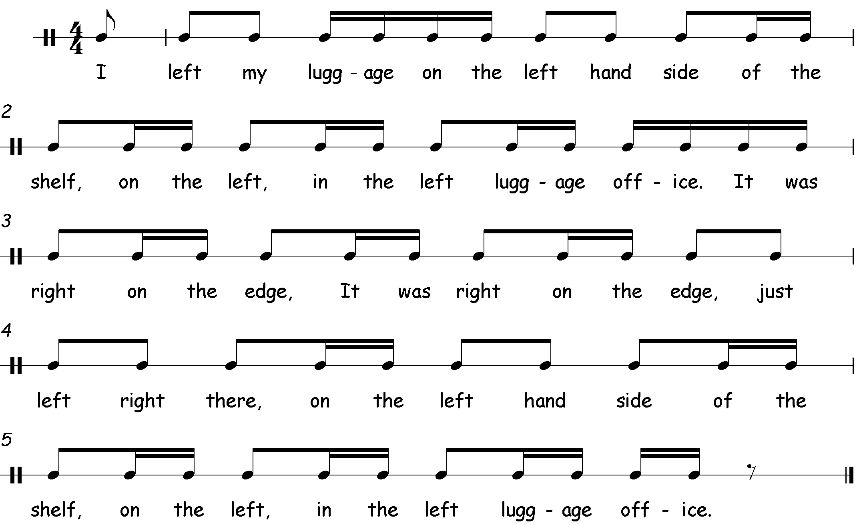
Left Luggage
This piece does not start on the first beat of the bar; it starts on the upbeat, known as an anacrusis.
Notes:
This piece is a chant rather than a song, so diction (pronunciation) is very important to make it coherent.
Things to Try:
Experiment with different (or graduated) dynamics, tempo, ‘voices’ (expression), instruments etc.
Perform it as a round.
Add actions such as stamping the left/right foot when the relevant word is spoken.
Internalise song words by only stamping left/right instead of singing.
Add different instruments to show left or right

Slide 18
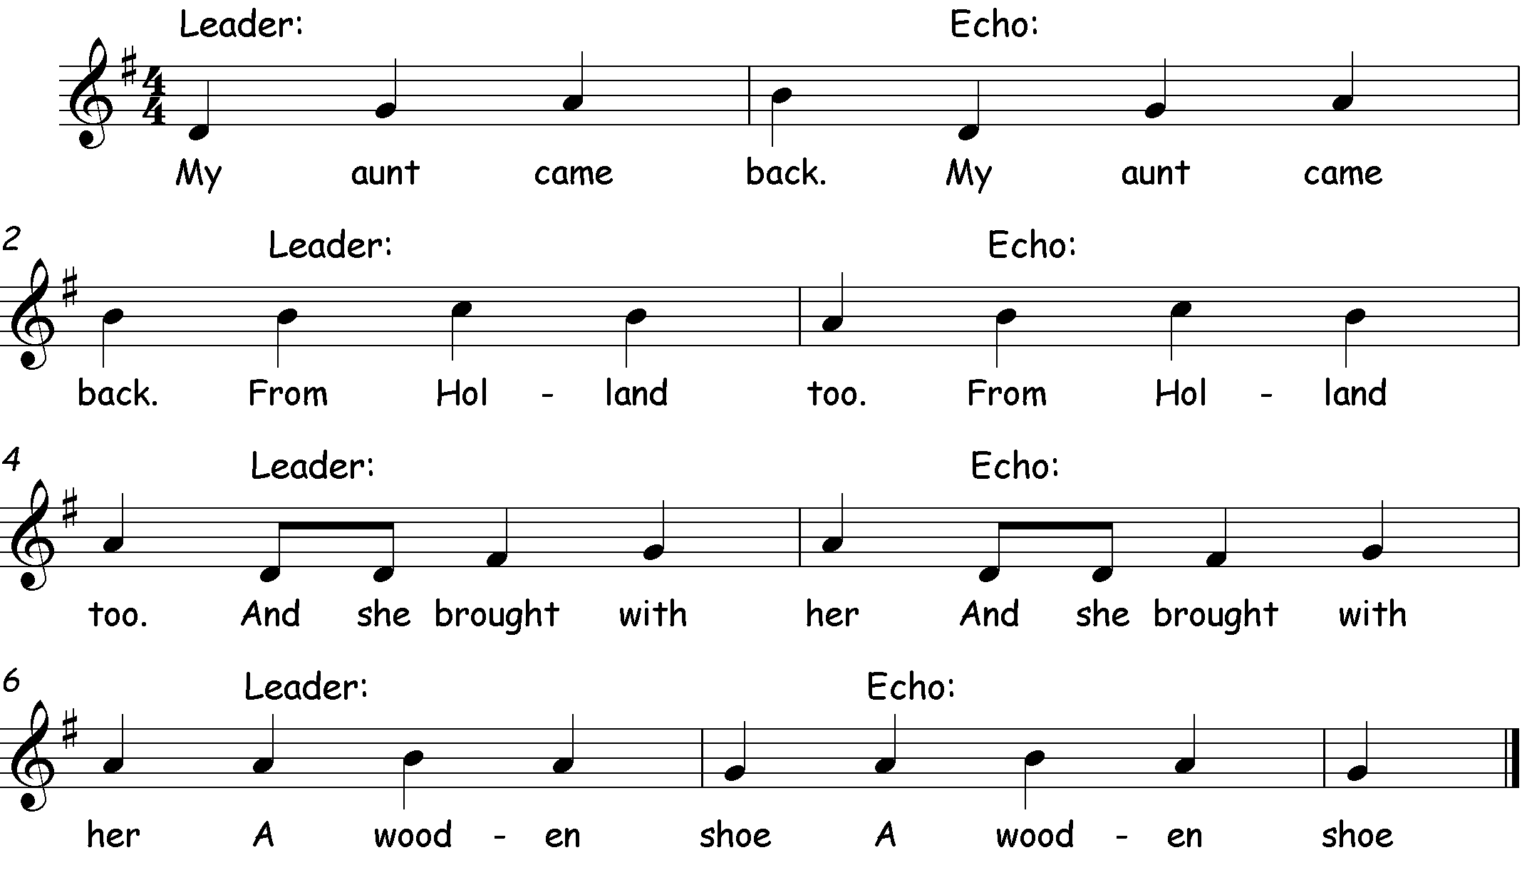
My Aunt Came Back…
Notes:
This is a simple song which can be used to develop confidence in performing solo or in small groups.
It moves mostly by step with some small leaps so the melody should be picked up quite quickly.
Things to Try:
Change country/family member/souvenir (could link to topic) whilst maintaining rhyming scheme (e.g. Stevenage ‘a great big fridge’)
(EXT choose items that are appropriate for the location)
Pitch matching; whatever pitch the Leader sings at the echo must match it. Explore different starting pitches; high and low. Where feels most comfortable?

Slide 19
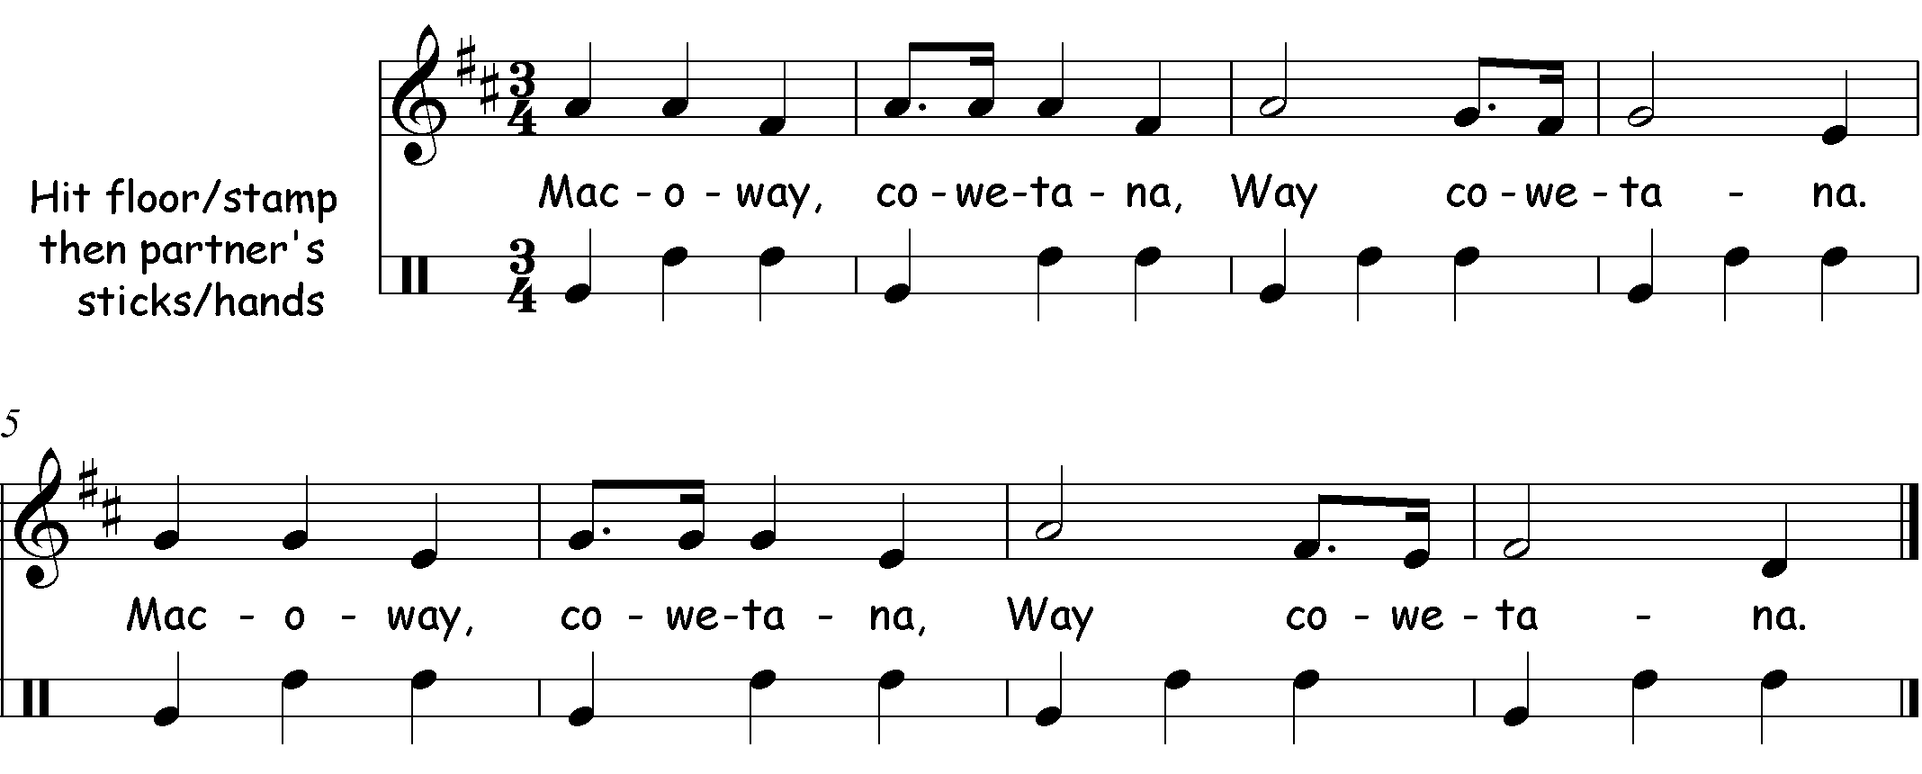
Macoway
This piece is a folk song and dance which has three beats in a bar instead of the more common four beats.
Notes:
Macoway is a nonsense folk song. It is sung in Maori and has no translation.
There are three beats in every bar.
Phrasing is very important in this song and as such, breath control needs to be a focus point to prevent it from sounding halting and clumsy. We suggest that you experiment with taking breaths after every bar, then every two and ultimately one for each (four bar) phrase. Use ‘rainbow arms’ (sweep arms over heads in a rainbow shape) to visually and physically clarify where each phrase occurs.
Things to Try:
Create an alternative rhythmic ostinato (repeating pattern) using body percussion. This could then be further extended to incorporate (untuned) instruments.

Slide 20
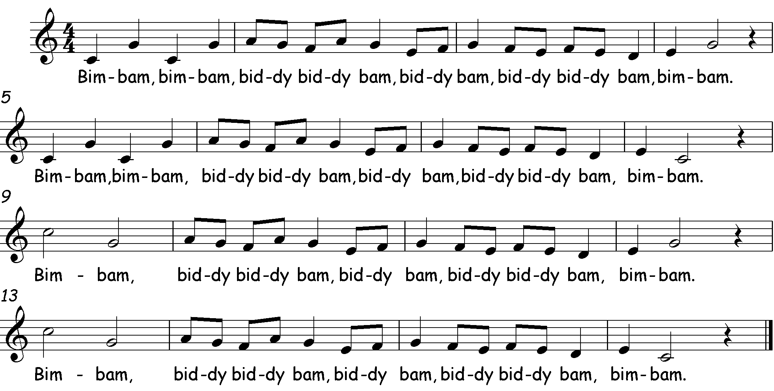
Bim-Bam
Bim = pat (knee pat)
Bam = clap
Biddy = click fingers (once)
For Tempo and Dynamic terms see slide 30
Notes:
This song has an octave range, with the highest note coming at the start of the final two phrases (bar 9 and 13 respectively).
This song can be performed at any tempo but be careful to maintain a steady pulse.
Breath control (especially at slow tempos) to maintain half/whole lines in a single breath.
For actions see teaching box on slide.
Things to Try:
Create an ostinato (repeating pattern) or drone (a sustained note) that can continue throughout the song to add depth to the texture (layers).
Could transfer the actions to untuned instruments whilst maintaining the vocal line (individually or in small groups).
‘Harry Potter Spell Game’
“Cantabile” casts a spell of tempo/dynamics on the class!
At the end of each repetition of the song a ‘spellcaster’ is chosen to cast the spell for the next verse/repetition. This gives children the opportunity to take ownership of the song, build their confidence when performing alone and they can even conduct the repetition (with a wand/baton/beater/drum stick) to further give them control over the music. This game can be used with any song.

Slide 21
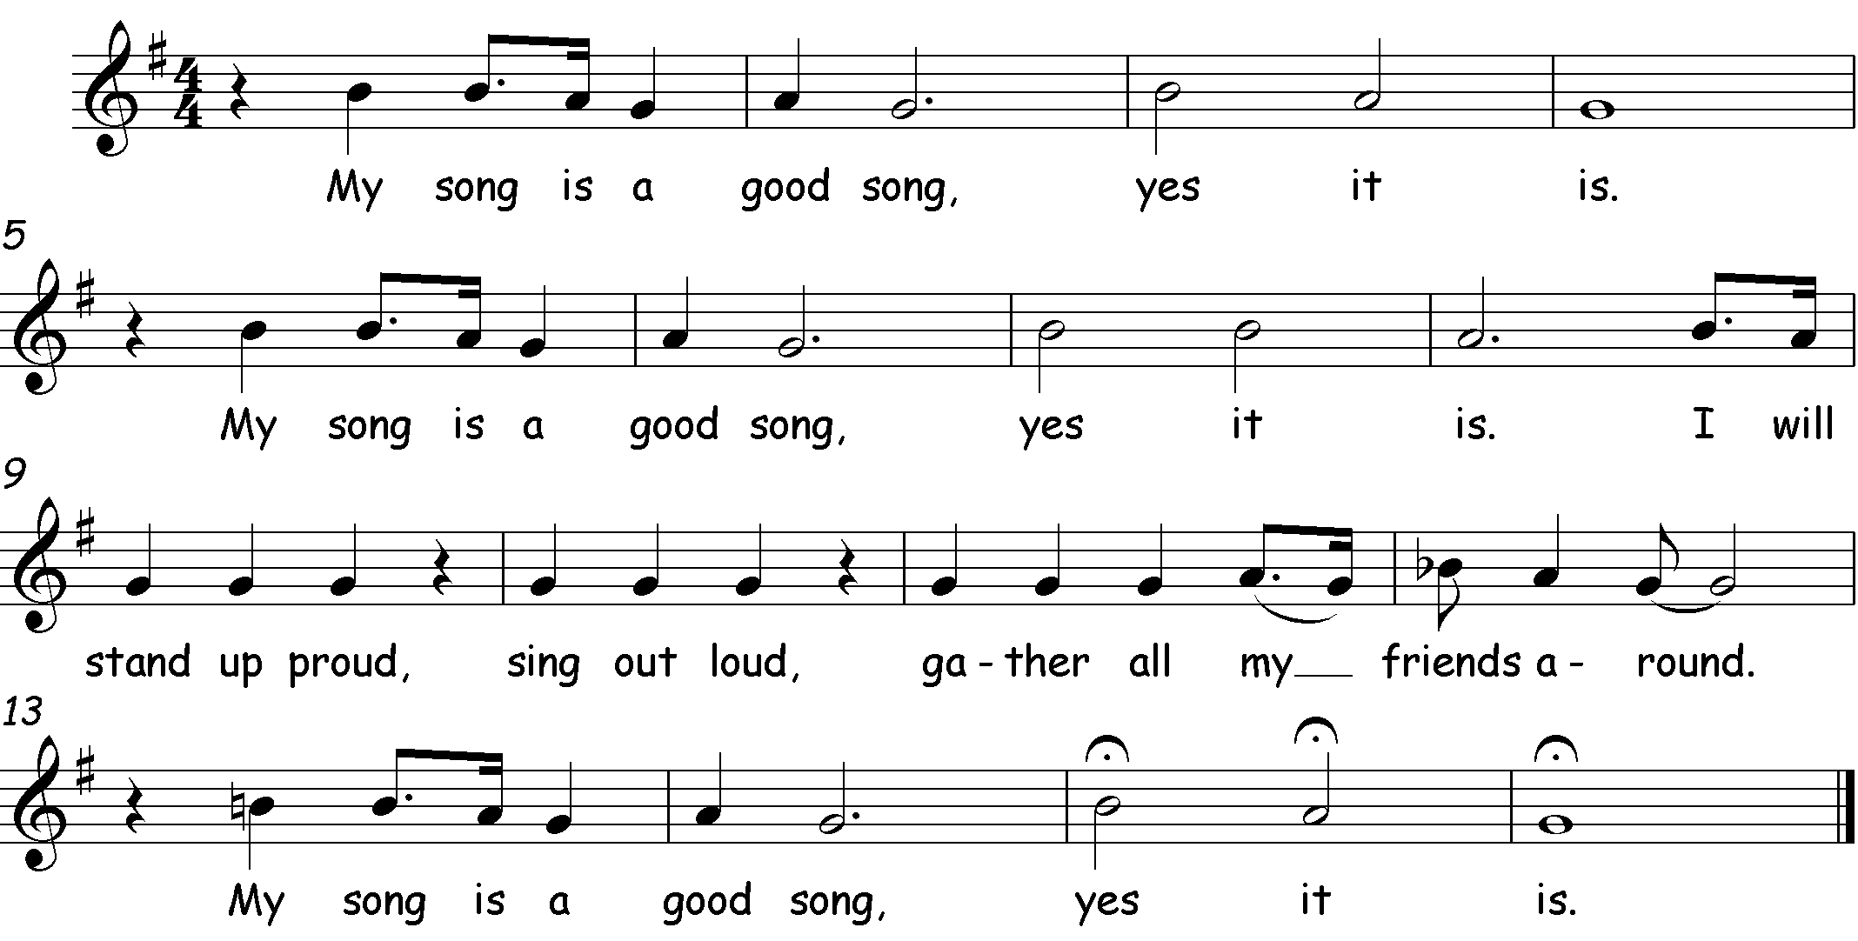
My Song is a Good Song
This piece does not start on the first beat of the bar; there is a rest on beat one. Can you think of an action to fill this rest?
Notes:
This piece makes use of varied rhythms and includes dotted rhythms which help to give it a swung, ‘jazzy’ feel.
Breath control is very important in this song to maintain quality of sound throughout the longer notes. If sufficient breath is not saved then the tone quality and/or tuning of the note (known as intonation) can suffer.
Things to Try:
Add an extra ‘good’ to each verse or choose a number of times to repeat it (e.g. “My song is a good, good song”)
Change the words e.g. change “song” to another word, such as pet etc.
Add actions/movements such as:
Clapping and swaying on or off the beat
Stand up proud – stand tall and proud
Sing out loud – hands besides mouth as though calling
Gather all my friends around – open hands to classmates
Internalise (use thinking voice) “yes it is” and ensure they start singing together again at the correct point.
To extend further:
Explain the ‘blue note’ on the word “friends” and discuss why it may have been placed there (phrasing, emphasis etc)
- A blue note is a jazzy note that is played or sung at a slightly different pitch than standard (in this case it is a Bb instead of a B)

Slide 22
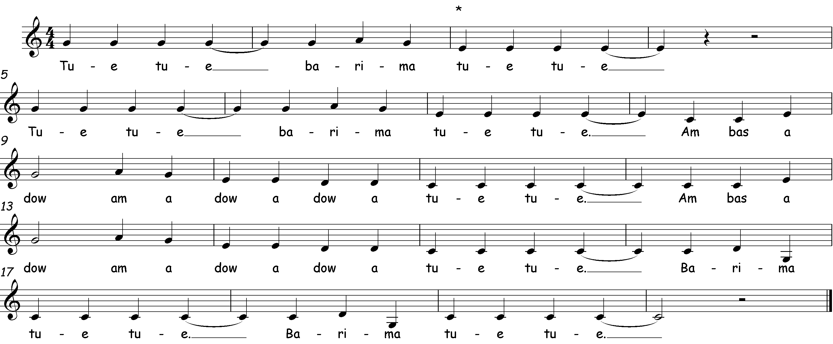
Tue Tue
This song can be performed in a round, group two starting when group one reaches the *.
Notes:
A traditional Ghanaian harvest song. The approximate translation is:
“Food, food, bring me food.
Barima cooks (lunch).
Bring her spices to make it taste better”
This song uses a pentatonic scale, meaning there are only five pitches available for use.
Once securely learnt, it can be performed in a two-part round, with the second part starting at the * indicated.
Things to Try:
Adding a pitched ostinato (repeating pattern) using the notes C and G
Creating your own actions such as tapping knees, side stepping, ‘harvesting’ style actions to the pulse etc.

Slide 23
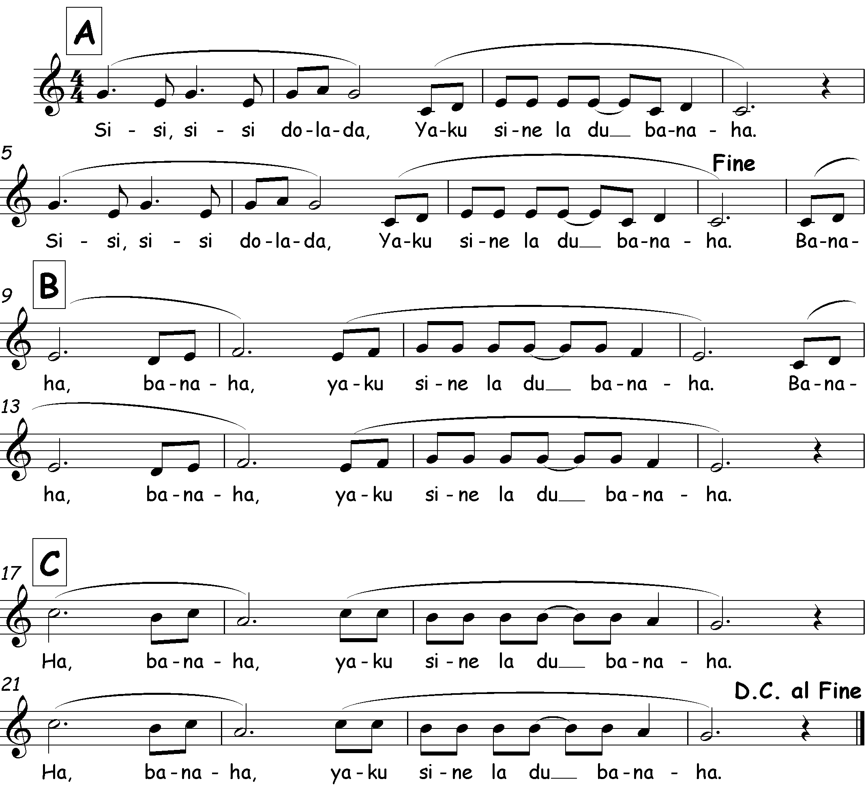
Si Si Si
D.C. al Fine means go back to the beginning (‘Da Capo’ meaning ‘the head’) and stop at Fine (meaning ‘finish’).
Notes:
There are three clear sections: A, B and C.
Phrases are indicated by the ‘rainbows’ and breaths should last the duration of each phrase to ensure that the melody flows smoothly.
The recordings show:
Sung in unison all the way through (structure = A, B, C, A)
Selecting two parts (in this case B and C) to be sung simultaneously (structure = A, B+C, A)
This song has a range of an octave.

Slide 24
Senwa Dedende
The second line uses a descending sequence. This means that the same phrase is repeated, each time at a lower pitch.
Optional ostinato (repeating pattern):
Notes:
This song is a traditional Ghanaian song. The approximate translation is:
“Senwa, your dinner’s ready”
Things to Try:
Add the ostinato line (use words until secure, then internalise and play the rhythm without speaking)
Use different children’s names in place of ‘Senwa’
Sing in two or four parts (see next slides)

Slide 25
Senwa Dedende (Two Parts)
Notes:
When performed in two parts there should be a whole bar between groups starting (starting 4 beats apart).
*The score ends at the end of the first full round; when the second part completes the melody (the final bar is therefore not missing but omitted, to allow the performers to decide how many repeats they wish to include)

Slide 26
Senwa Dedende (Round)
Notes:
Parts 2-4 enter when part 1 has reached the relevant asterisk (*) in the melody (each entry is two beats after the previous).

Slide 27
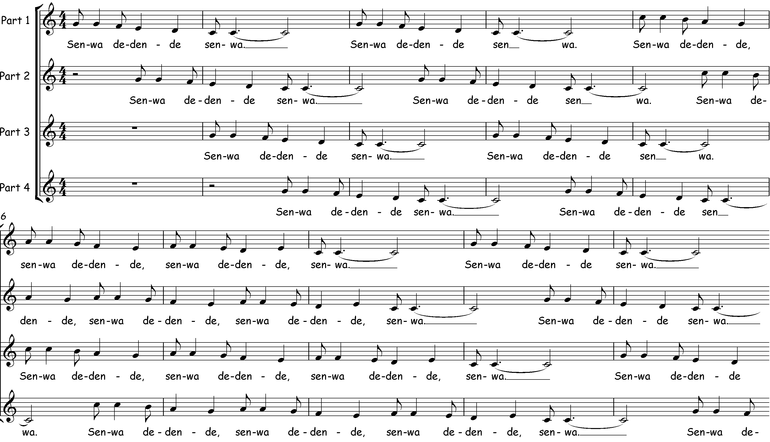
Senwa Dedende (Round) alternative notation
Notes:
*The score ends at the end of the first full round; when the fourth part completes the melody (the final bar is therefore not missing but omitted to allow the performers to decide how many repeats to include)

Slide 28
Senwa Dedende cont. (Round) alternative notation
Notes:
*The score ends at the end of the first full round; when the fourth part completes the melody (the final bar is therefore not missing but omitted to allow the performers to decide how many repeats to include)

Slide 29
Throw Catch
To create the syncopated rhythm, there are a number of half-beat, or quaver, rests both during and at the start of some bars.
This piece uses syncopation. This means that some notes use ‘weak’/off beats instead of the ‘strong’ beats. Beats 1 & 3 are typically the ‘strong’ beats so any other beat or division of those beats are considered ‘weak’.
Notes:
This song has the range of a seventh with some large leaps.
Part one can be sung as a standalone song. Part two (see next slide) should be learnt separately before trying to sing in harmony
Actions:
Mime throwing and catching on the appropriate words
“Jikeleza” means turn around in the Xhosa language, so pupils should turn around on the spot
Stamp/dig your foot before each “na na na na na na”
Things to Try:
Put the class into two lines, facing each other, have them throw an invisible ball back and forth singing throw/catch when they complete the action (they need to pay attention to where the ‘ball’ is after the first “jikeleza”). For the “na na na…” section the lines could take turns and/or sing together.
EXT Learn the harmony line (see next slide) and sing in two parts

Slide 30
Throw Catch

Slide 31
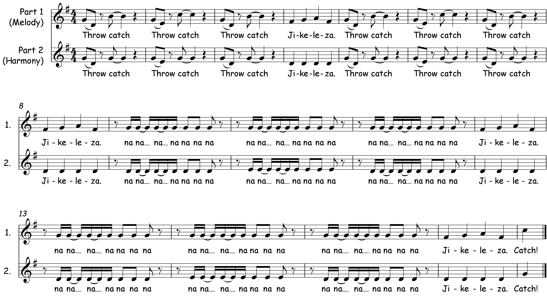
Throw Catch cont.

Slide 32
Bella Mamma
Breath control is very important in this song in order to keep the notes sounding consistent all the way through, even when they’re very long. The “oh” notes are all 4 beats long, called semibreves, and it is important that they last the whole 4 beats.
This is a breath mark and is where you should aim to breathe (silently, without ‘gasping’)
Notes:
This song uses syncopation and dotted rhythms and should be sung at quite a slow tempo (speed).
Encourage singing ‘to the end of the note’ to prevent a weak trailing off of sound. This requires children to control their breath and not let it all out too quickly in order to last the full two bars of each phrase.
There is a tendency to slide (portamento) between notes on the descending passages, this sounds very untidy so should be avoided and be challenged when it occurs.
Things to Try:
Try changing the mood of the song by experimenting with the tempo (speed), dynamics (how loud/soft), articulation (drawn out smooth notes or short jerky notes) etc.

Slide 33
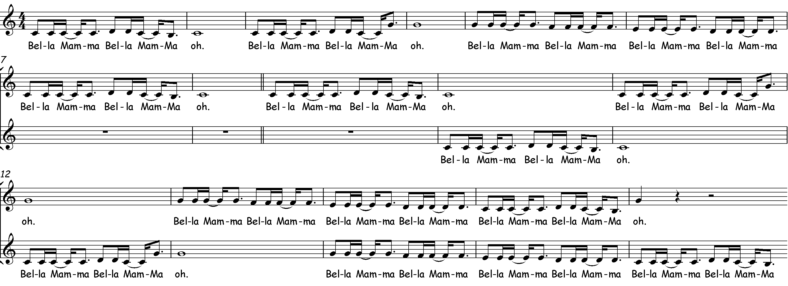
Bella Mamma
Notes:
Learn phrases very securely before trying to layer them together as it is harder than it seems!

Slide 34
Bella Mamma cont.

Slide 35
Bella Mamma cont...

Slide 36
My Pet Can
Notes:
Diction is important, especially when using a fast tempo, in order to understand the words.
The music is familiar to most children but accuracy should not be sacrificed; check what they are singing to ensure quality.
This piece has a full octave range, including an octave leap followed by descending scale at speed.
Children will need to exercise some self control; it’s all good fun but it cannot work if everyone dissolves into giggles or rushes and destabilises the beat needed for effective and clear unison singing.
Things to Try:
Instead of singing the animal, make the noise in the appropriate place. This is delightfully silly and has the added bonus of subtly developing their head and chest voices as well as stretching facial muscles, all whilst developing their ability to internalise words and sounds.
Woof (chest voice)
Miaow (head voice)
Goldfish (fish face, suck cheeks in and pucker lips)
Try changing the order of the animals
Try using different animals and sounds. Add actions to accompany animal sounds.
Try using thinking voices for the words and only perform the sounds and actions. Can they perform them accurately together? How can they ensure that they keep together? (use of “musical eyes” for non-verbal communication and visual beat keeping)

Slide 37
Glossary
Tempo (speed)
Dynamics (loud/quiet)
Allegro - fast
Andante - walking pace
Lento - slow
Accelerando - getting faster
Ritardando - getting slower
Piano (p) - quiet
Mezzo piano (mp) - medium quiet
Mezzo forte (mf) - medium loud
Forte (f) - loud
Diminuendo (>) - getting quieter
Crescendo (<) - getting louder

Slide 38
Copyright Notice
We have made every effort to trace the copyright owners of the songs within these songbooks (with the majority of the songs being in the public domain already). If we have not acknowledged any copyrighted material, please contact us immediately.
Thank you to Rachel Thomas (Dawson) and Joan Wright, for the original Songbook 1&2 concept and content.
Many thanks to Joan Wright (formally a member of the Hertfordshire Primary Music Team) for generously letting us use her songs and adaptations of songs and lyrics – ‘Dads, Lads, Girls, Mums’; ‘Henry King of England’; and ‘Dean Bon Bean’.
Additional thanks to all of the past and current members of the Hertfordshire Music Service Primary Music Team.
Thank you to Lucinda Geoghegan for allowing us to use ‘Left Luggage’: ‘’From Singing Games and Rhymes for Middle Years 1 published by NYCOS and used with permission”.
‘The material ‘Tue Tue’ (traditional Ghanaian song – author unknown) is reproduced with the permission of Oxfam, Oxfam House, John Smith Drive, Cowley, Oxford OX4 2JY, UK www.oxfam.org.uk. Oxfam does not necessarily endorse any text or activities that accompany the materials.’
We have included a bibliography to credit the authors/publishers of the books where we sourced many of these traditional songs.

Slide 39
H.E.L.L.O
Collected and edited by Margaret Anderson. Skidmore, Jeffrey. Singing Playgrounds. Published by Ex Cathedra.
2. Left Luggage - Traditional rhyme.
’From ‘Singing Games and Rhymes for Middle Years 1’, published by NYCOS and used with permission of Lucinda Geoghegan”
3. My Aunt Came Back - Traditional American folk song
‘Songs to Sing & Sing Again’; also found in ‘The Kids' Campfire Book’, Jane Drake and Ann Love, Kids Can Press, 1996
4. Macoway - Folk song from New Zealand
5. Bim-Bam - American folk song. Waldorfschoolsongs website: Bim bam biddy biddy bam | 9-10 jaar | 11-12 jaar | eenstemmig | onzintekst (waldorfschoolsongs.com)
6. My Song is a Good Song
Whitlock, Val and Court, Shirley (from ‘My Dog is a Good Dog’) ©David Lawrence, 2002. Singing Sherlock Book Two. Published by Boosey and Hawkes, 2004.

Slide 40
7. Tue Tue - Folk song from Ghana. Copyright owned by Oxfam GB:
‘The material “Tue Tue (traditional Ghanaian song – author unknown)” is reproduced with the permission of Oxfam, Oxfam House, John Smith Drive, Cowley, Oxford OX4 2JY, UK www.oxfam.org.uk. Oxfam does not necessarily endorse any text or activities that accompany the materials.’
8. Si Si Si –
Whitlock, Val and Court, Shirley. Singing Sherlock Book Two. Published by Boosey and Hawkes, 2004 © Boosey and Hawkes, 2002.
9. Senwa Dedende – Traditional folk song from Ghana
Geoghegan, Lucinda and Norbert Nemes, László. Singing Games and Rhymes for ages 9 – 99. Published by the National Youth Choir of Scotland, 2014.
10. Throw Catch - Arrangement from Soundscape? Words and Music by Sikhumbuzo Tshona. Arranged by Sharon Durant. Sing Up?
11. Bella Mamma - Traditional song from Torre Straits (island near Australia)
12. My Pet Can

