Slide 1
Managing Behaviour in Large Groups
First Access CPD
February 2014

Slide 2
Environment
How is your room set up?
How does it get set up?
What resources do you use?
Is it well organised?

Slide 3
Seating Plans… 30 in a circular pattern

Slide 4
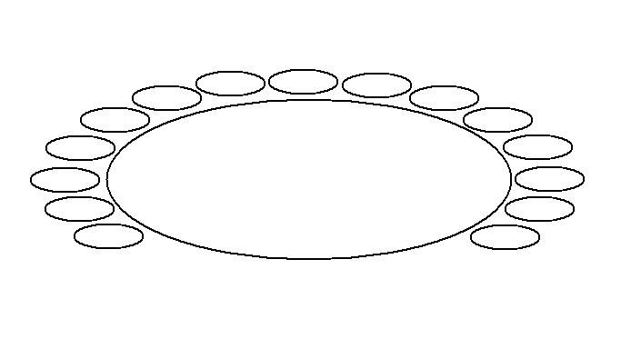
15 in a semi-circle

Slide 5
15 in a block

Slide 6
Running the lesson
Routine
Engage in activity
Freeplay
Raise their expectation – don’t be afraid to wait
Strategies for stopping
Talk as little as possible – use gestures/sing instead!
Pace

Slide 7
Managing Naughty Behaviours
Why are children naughty?
How do you react?
Ignore
Time out
Removal

