Slide 1
What are the indicators of an inclusive music service?
A tool that has been co-created by music services and/or hub lead organisations.
Version 2, January 2021

Slide 2
About this tool
This document is the latest version of a collaborative working document, intended to help discussion and planning in music services and hub lead organisations. It has been created* by Changing Tracks, based on the experiences of music services who are part of the National Music Services Working Group on Inclusion, particularly Hertfordshire Music Service.
Who is it for? It focuses on the particular challenges for ‘music services’, as organisations, to become inclusive - whether they are still local authority-run or have moved out of local authority control.
Music services are constantly changing and innovating - challenging exclusive practices (see page 3) that can become hidden by unquestioned traditions. Each service is at different place on our journey to address this, but we all face common challenges, and will all recognise some of the ‘exclusion’ indicators listed on page 3.
How do I use it?
The diagram and tool ask you to consider how inclusion becomes integrated within music services as a process (ie: it does not depict the progression of a particular cohort of young people). We think it’s most helpful as a discussion tool in team meetings, alongside Youth Music’s EDI audit spreadsheet and action plan template and their Evidencing how hubs are becoming more inclusive guidance for hubs.
What next?
We’re here to help - visit our website for resources, or email us at HMSinclusion@hertfordshire.gov.uk to keep in touch and find out about opportunities and support including support with EDI planning and CPD.

Slide 3
Stage 1 - exclusion
CCC is a shorthand term for any young person facing barriers to making music. This might include economic and life circumstances, disability, learning disability, health conditions, social, emotional and mental health difficulties, but there are also many other barriers.
Pupil voice | Settings & delivery | Current workforce | Progression routes | Music service recruitment | CPD | Funding
Children in Challenging Circumstances (CCC)* do not participate in and/or have no voice in developing music service activities. | Are inaccessible or feel unwelcoming to CCC. No existing partnerships with local communities, agencies supporting CCC e.g. local authority (LA) teams such as early help, school improvement, children in care, etc, or SENCOs within schools | Tutors unable or unwilling to adapt their practice to the interests and needs of CCC. ‘Instruct’, rather than dialogue with pupils. Diversity of potential learners not reflected in workforce. Teaching focuses on grades or a cannon of repertoire over co-creating material. Unaware of availability of assistive tech/ adapted instruments | Not appropriate to CCC. Focus on musical progress only. Take a pyramid approach: e.g. focusing support on the progression of fewer, more technically able pupils. | Focuses solely on conservatoire tutors and values: e.g technical proficiency on their instrument or voice. Values attendance of particular institutions, and experience of teaching grade examinations, over experience/expertise/ ability to engage, inspire and progress a wide range of learners. | Training and quality systems focus on technical instruction, repertoire and inclusion via ‘unity of purpose’, rather than differentiation. | Participation for CCC available only through schools programmes such as WCET/First Access No investment in/ subsidy of ongoing CCC activities. Subsidy allocated to those considered to be 'musically talented', judged by technical proficiency on Western classical instruments

Slide 4
Your discussion notes for exclusion page

Slide 5
Stage 2 - segregation
Pupil voice | Settings & delivery | Current workforce | Progression routes | Music service recruitment | CPD | Funding
Pupils contribute to planning of activities, but projects run for CCC separate from others. | Short term projects run in PRUs/ESCs, Youth Clubs/Special Schools or for targeted groups within schools. Adapted instruments/assitive technology available, but on limited local basis, rather than as part of promotion of core offer. | Some inclusive practice, but run by community musicians from outside the music service, or by a small inclusion team within it | One-off performances in venues, but no accessible progression into other ongoing music service/hub/local activities’. End of term concerts for CCC only. | Inclusive activities run by freelancers on short-term contracts | Community musicians/ organisations CPD runs separately to music service tutors, or for a small ‘inclusion team’ within a music service. | Activities run only when external funding is available. Match funding not sourced to provide sustainability.

Slide 6
Your discussion notes for segregation page

Slide 7
Stage 3 - integration
Pupil voice | Settings & delivery | Current workforce | Progression routes | Music service recruitment | CPD | Funding
CCC participate alongside others in activities and may have some say in their design, but activities are largely tutor-designed and led. | Make some adjustments to welcome a more diverse range of learners. Bespoke activities run in music service/hub settings (or other settings if more appropriate), but may take place as ‘after hours’ or weekend events. | Tutors adapt their practice to a degree, but inclusion is largely within ‘business as usual’. | CCC play in school or music centre orchestras/ ensembles but other progression routes not available or signposted. | Some specialist inclusion tutors are recruited. Payspine reflects specialist skills and experience of community musicians. | Some specialist training or sharing of practice, but outside regular CPD offer and not offered to all music service staff. | Bursary/remission of fees schemes support FSM pupils to participate.

Slide 8
Your discussion notes for integration page

Slide 9
Stage 4 - inclusion
Pupil voice | Settings & delivery | Current workforce | Progression routes | Music service recruitment | CPD | Funding
CCC participate in co-created activities which meet their musical interests and needs, and allow them to express their lived experience. | CCC have a choice of weekly activities and take part in weekly sessions in music centres alongside other activities. Music centres are located in settings accessible for all. School musical communities are inclusive of all. Adapted instruments/ assitive technology available to all as needed. | All tutors adapt their practice to the interests and needs of CCC, refer and monitor uptake of progression opps. Diverse workforce representation suggests careers accessible to CCC. Tutors report personal and social outcomes alongside musical. Has a regular voice in the development of E, D and I action planning. Clear career progression routes available to all | Diverse and accessible progression routes are available throughout county, are actively promoted by all, and take up monitored. Includes opportunities for progression appropriate to participatory music cultures, such as young music leadership. | Engagement of and improvement of outcomes for CCC are prioritised in allocation of contracts and deployment of staff. | Encourages critical reflection, differentiation and listening and responding to pupils rather than ‘telling mode’, creativity as well as technique. Acknowledges and introduces the specialist skills of inclusion tutors, and the lived experiences of tutors. Diverse range of tutors compare notes regularly. | Core funding invested to best target and improve outcomes for CCC, with inclusion KPIs Supports personal and social as well as musical outcomes. Focuses on developing ongoing, inclusive musical communities, within schools as well as central activities.

Slide 10
Your discussion notes for inclusion page

Slide 11
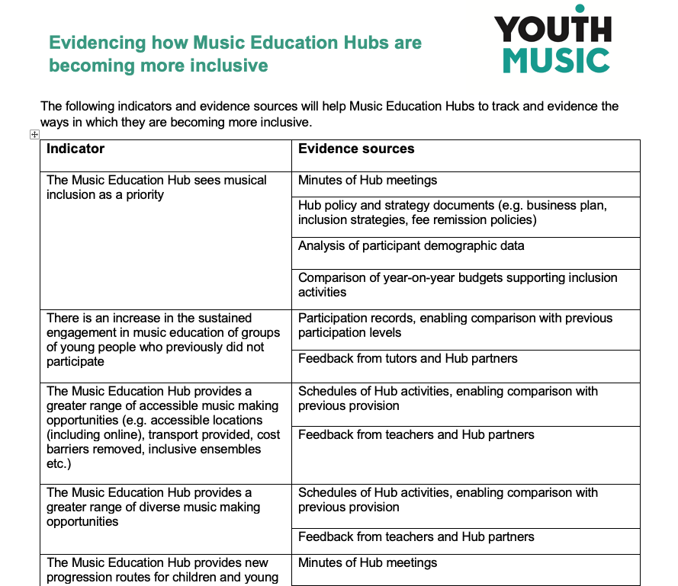
Youth Music’s latest guidance for
hubs (for their hubs fund).
11 indicators
26 example sources of evidence
http://bit.ly/YMHubGuidance2

Slide 12
Youth Music’s latest guidance for
hubs (for their hubs fund) continued.

Slide 13
Youth Music’s other guidance for
hubs.
Developing an inclusive approach to the core and extension roles – including examples of good practice.
http://bit.ly/YMHubGuidance1

Slide 14
Get more useful resources created with and for music services at HMS Changing Tracks (hertsmusicservice.org.uk)

